Slide 1
Data Science Mega Tool-Set Comparison and Model

Slide 2
Distributed Systems CT-509
Instructor
Dr. Ayaz ul Hassan Khan

Slide 3
Team
Jibran Rasheed Khan | MSIS-010/2018
Muhammad Waqar | MSIS-011/2018
Hafiz Idrees Riaz | MSIS-025/2018

Slide 4
Outline
Objective
Data
Forms, Types, Classification
Analysis
Analytics
A vs A
Analytics Tools
Big Data
Pillars
Sources & Data Lake
Model
Analytics
Tools
Algorithms
Classification
Big Data & Analytics Algorithms
Comparison
Technology
Tools
Feature
Use
New Propose Model
Conclusion

Slide 5
Objectives
Our objective is to study a wide variety of Tools / Algorithms / Techniques and make a centralized platform or Framework where different nature of tools are categorized for the ease of use for Data Scientists and this will be helpful for the future enhancement of Data Science.

Slide 6
DATA
FORMS, TYPES, CLASSIFICATION, ANALYSIS, ANALYTICS, A vs A, ANALYTICS TOOLS

Slide 7
THE DATA
DEFINITION
It is something that could be measured, collected, reported, analyzed, stored, and whereupon it can be visualized using graphs, images or other analysis tools.
Data, in general concept refers to the facts that has information or knowledge.

Slide 8
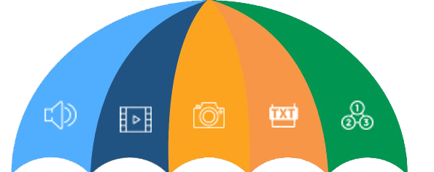
DATA: FORMS
CORE DATA FORMS
Number
Text
Image
Audio
Video
Audio Video Image Text Num

Slide 9
DATA: TYPES
Observational
Simulation
Experimental
Derived or Compiled
Machine
Time-stamped
Spatiotemporal
Open
Dark
Real time
Operational
Audio Video Image Text Num
Observational Simulation
Experimental Dark Derived
Compiled Open
Machine Time-stamped Operational
Spatiotemporal Real time
….. … ….. ... ….. ...

Slide 10
DATA: CLASSIFICATION
First Level
Structured
Semi-structured
Unstructured
Second Level
Qualitative
Quantitative
Geographical Base
Chronological or Temporal

Slide 11
DATA: ANALYSIS
DEFINITION
It is the process of examining information, especially using a computer, in order to find out something, or to help with making decisions out of it.
Example Tools
OpenRefine, KNIME,
RapidMiner, Google Fusion Tables,
Tableau Public, NodeXL,
WolframAlpha tools are used.

Slide 12
DATA: ANALYTICS
DEFINITION
It is the process of examining data sets in order to draw conclusions about the information they contain, increasingly with the aid of specialized systems and software.
Example Tools
R, Tableau Public,
Python, SAS,
Apache Spark,
Excel, etc

Slide 13
Analytics vs Analysis (A vs A)
Basis | Data Analytics | Data Analysis
Form | Used in businesses to make decisions from data which are data-driven | used in businesses to analyze data and take some insights of it.
Structure | Consist of data collection and inspect in general and it has one or more users. | Consisted of defining a data, investigation, cleaning, transforming the data to give a meaningful outcome.
Tools | Example tools in a market but mainly R, Tableau Public, Python, SAS, Apache Spark, Excel are used. | Example tools OpenRefine, KNIME, RapidMiner, Google Fusion Tables, Tableau Public, NodeXL, WolframAlpha.
Process Sequence | Business Case Evaluation, Data Identification, Acquisition & Filtering, Extraction, Validation & Cleansing, Aggregation & Representation, Data Analysis, Visualization, Utilization of Analysis Results. | Data gathering, scrubbing, analysis and interpret precisely so that one can understand what data want to say.
Usage | It can be used to find masked patterns, anonymous correlations, customer preferences, market trends that can aid in to notify decisions for business purpose. | It may be descriptive analysis, exploratory analysis, inferential analysis, predictive analysis and take useful insights from the data.
Example | 1GB customer purchase data of past 1 year, one has to find that what our customers next possible purchases. | 1GB customer purchase data of past 1 year, one trying to find what happened so far, having look into past.

Slide 14
BIG DATA
PILLARS, SOURCES, DATA LAKE, MODEL, TOOLS

Slide 15
Big Data
DEFINITION
Extremely large data sets that may be analyzed computationally to reveal patterns, trends, and associations, especially relating to human behavior and interactions.
Big data is a term that describes the large volume of data – both structured and unstructured – that inundates a business on a day-to-day basis. But it’s not the amount of data that’s important. It’s what organizations do with the data that matters. Big data can be analyzed for insights that lead to better decisions and strategic business moves.

Slide 16
Big Data: Pillars
Storage
Processing
Orchestration
Assistance
Interface
Deployment

Slide 17
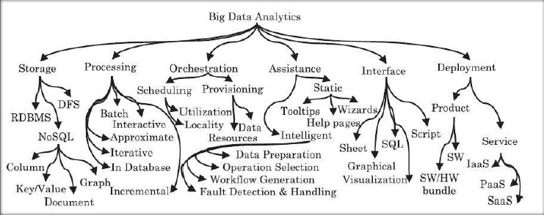
Big Data: Pillars

Slide 18
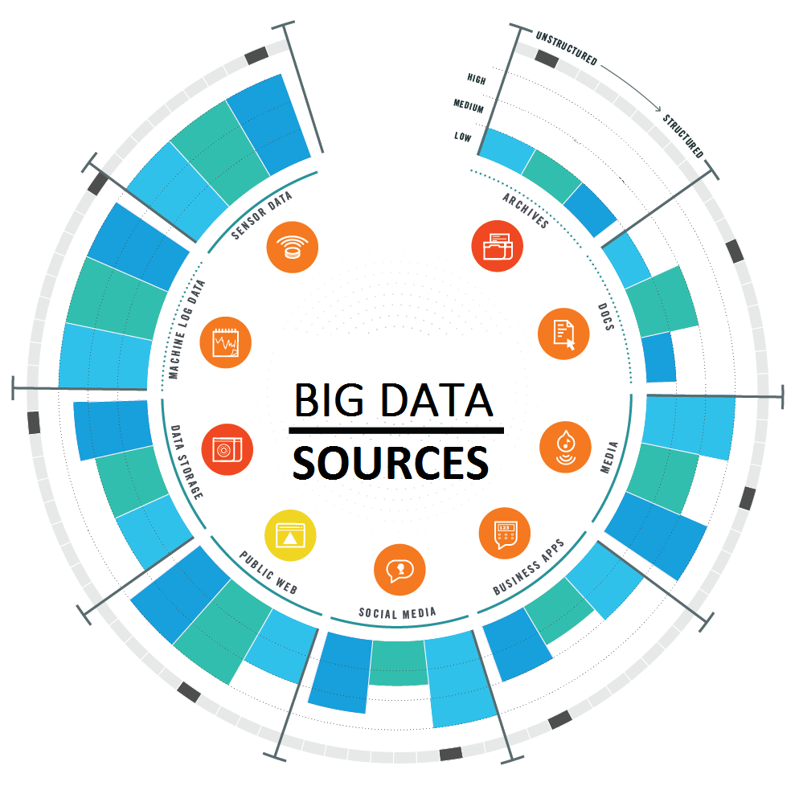

Slide 19
Big Data: Tools
Hadoop
Hadoop software library is a framework
Help in distributed processing of large data sets across clusters of computers
Two method to start single node or cluster mode
Latest stable version is 2.9.2
Few Important features are HDFS, YARN,MAPREDUCE, cost efficient, Hadoop libraries and many more

Slide 20
Big Data: Tools
SPARK
Apache Spark is the alternative — and in many aspects the successor — of Apache Hadoop.
Built to address the shortcomings of Hadoop.
Apache Spark achieves high performance for both batch and streaming data.
Run workload 100X faster.
Offers over 80 high-level operators that make it easy to build parallel apps.
It powers a stack of libraries including SQL and Data Frames, MLlib for machine learning, GraphX, and Spark Streaming
Latest stable version is 2.4.0 with multiple advance features

Slide 21
ALGORITHM
Does, USED, Classification, for DM, Da, BD

Slide 22
Algorithm
DEFINITION
In mathematics and computer science, an algorithm is an unambiguous specification of how to solve a class of problems.
Or
It is a procedure or formula for solving a problem, based on sequence of specified actions.

Slide 23
Algorithm: DOES and USED
WHAT IT DOES?
Follow instructions code
Calculation (Logical/Mathematical)
Data Manipulation
Data Processing
IT IS USED FOR
Searching
Sorting
Scheduling
Automated Reasoning
Automate Operations/Tasks

Slide 24
Algorithm: Classification
Algorithms have widespread range, almost in every expect of study and life. Here only concern with the Statistical/Computational statistics, Data mining, Machine learning algorithms. These classified as:
Supervised Learning e.g: Nearest Neighbor, Naive Bayes, Decision Trees, Linear Regression, Support Vector Machines (SVM), Neural Networks
Unsupervised Learning e.g: k-means clustering, Association Rules, mixture models, Self-organizing map, Expectation–maximization algorithm (EM)
Semi-Supervised Learning e.g: Generative method, Low-density separation method, Graph-based method, Heuristic method
Reinforcement Learning e.g: Monte Carlo, Q-learning, SARSA, DQN, A3C, NAF, PPO, TRPO

Slide 25
Algorithms: Classification by Learning
Algorithm
Supervised
Semi-Supervised
Reinforcement
Continuous Target Variable
Categorical Target Variable
Categorical Target Variable
Categorical Target Variable
Target Variable not Available
Target Variable Not Available
Unsupervised
Classification
Control
Classification
Clustering
Association
Clustering
Classification
Regression

Slide 26
Algorithm: Classification by Type
Association Rule
Artificial Neural Network
Bayesian
Decision Tree
Ensemble
Deep Learning
Clustering
Dimensionality Reduction
Regression
Regularization
Instance-based

Slide 27
COMPARISON
Technology, Tool, Features, Use

